Slide 1
Data Structures - Arrays

Slide 2
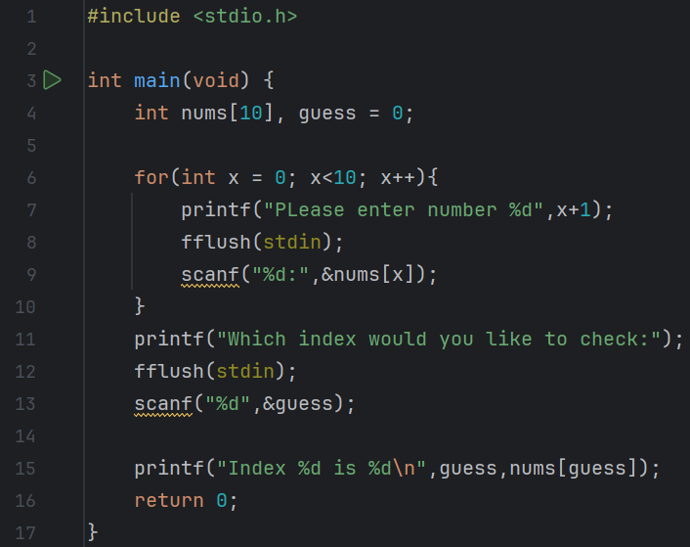
Predict
What do you think this code does?
Asks the user to enter 10 numbers. After that asks them to enter which index they want to see the value of. For example, the 2nd index would be the 3rd number they entered because there is an index 0 in programming.

Slide 3
Run
Download the code from Github and run it!
What does the code do?
Asks the user to enter 10 numbers. After that asks them to enter which index they want to see the value of. For example, the 2nd index would be the 3rd number they entered because there is an index 0 in programming.
Does this match your prediction?
Yes.

Slide 4
Investigate
Investigation Activities
What is the name of the variables being used? guess What data types does they hold? integer Annotate lines 4-16 to explain what each line of code does. What does fflush(stdin) do? Clears the output buffer

Slide 5
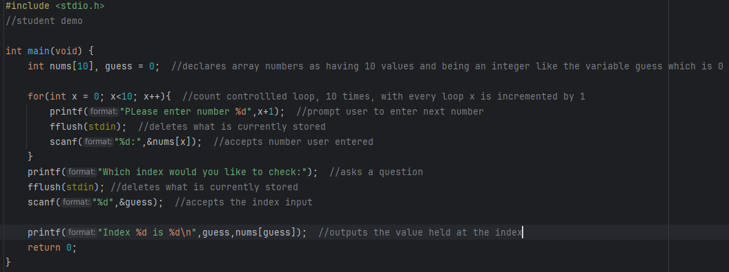

Slide 6
Modify
Modification Activities

Slide 7
Make
Make Activities
Create / edit the program on the last slide so that ten scores are stored. The program should then use a loop to show the user the outputs stated below: Requirements: The average score is output to the user The program outputs how many of the scores entered are higher than the average score The program finds and shows: The highest score in the list The lowest score in the list

Slide 8
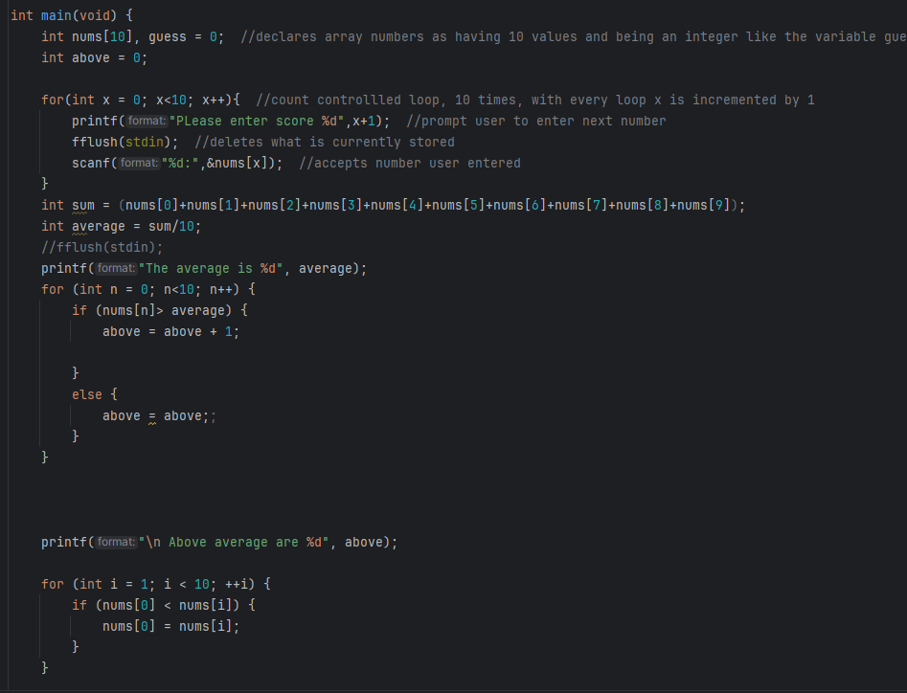
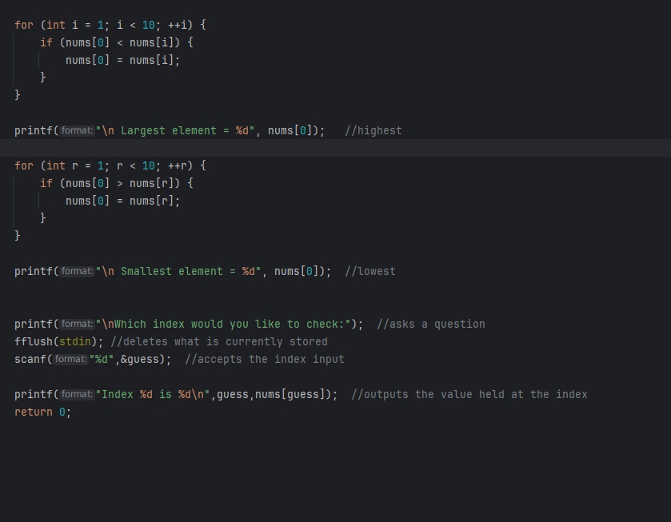
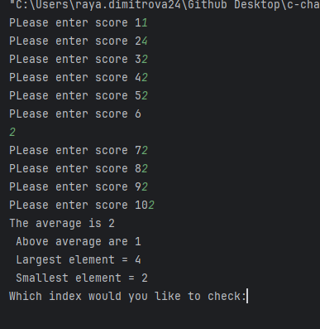

Slide 9
Make
Make Activities
Write a program that will store 5 numbers into an array and then show the data in reverse. Requirements: The user should input the 5 numbers The program should output two messages as shown below: The values stored are: 3, 7, 9, 1, 8 The reverse order is: 8, 1, 9, 7, 3

Slide 10
Make
Make Activities
Write a program that will fill an integer array with 20 random numbers between 1 and 10. It will then output how many of each digit is stored in the array. Requirements: The program should use a loop to auto-generate the numbers to store in the array Another loop should then be used to move through the array to count the total for each digit These totals should be output to the user

Slide 11
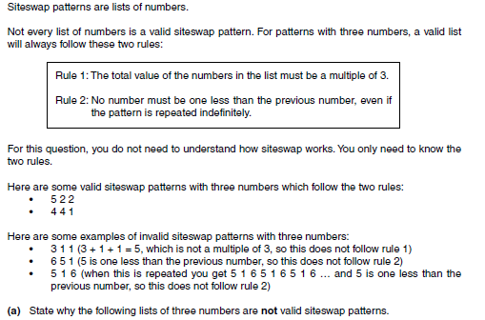
Make
Make Activities
Write a program that tests for Siteswap patterns, it should allow the user to enter 3 numbers into an array and then output valid or invalid based on the rules shown above.

